Slide 1
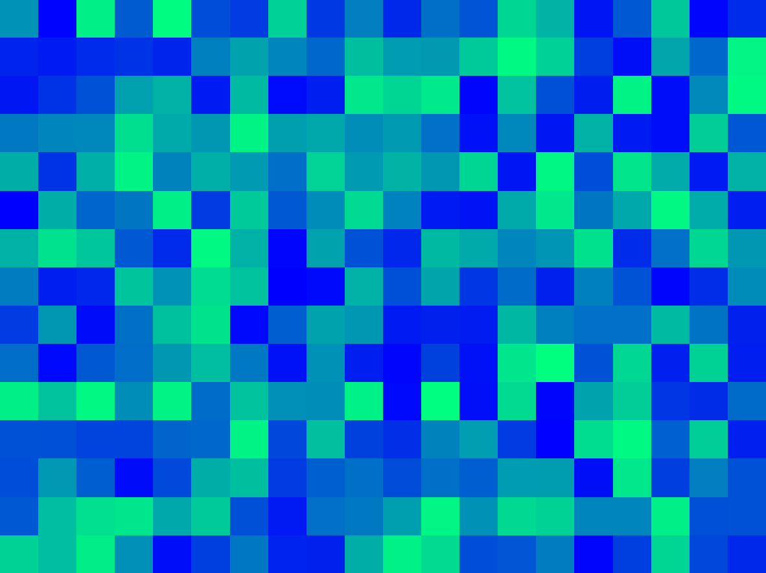
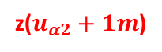
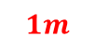
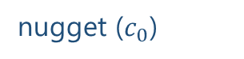
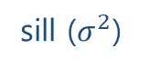
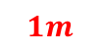
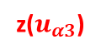
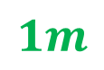
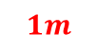
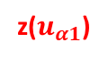
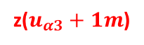
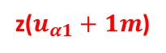

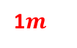
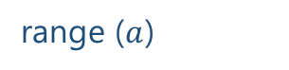

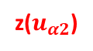
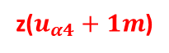
$$1m$$
variance ($γ$)
z($u_{α1}$)
z($u_{α1}+1m$)
sill ($σ^{2}$)
$$1m$$
$$1m$$
1$m$
nugget ($c_{0}$)
z($u_{α4}$)
z($u_{α4}+1m$)
z($u_{α2}$)
z($u_{α2}+1m$)
$$1m$$
range ($a$)
z($u_{α3}$)
z($u_{α3}+1m$)
lag distance (h)

Slide 2
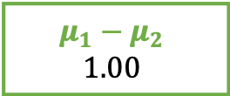
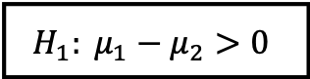
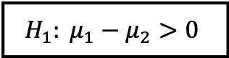
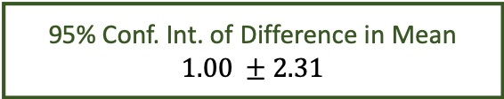
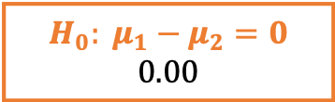
95% chance that difference in mean
falls between -1.31 and 3.31
Lower Limit
Lower Limit
-1.31
3.31
95% Conf. Int. of Difference in Mean
$$1.00 ±2.31$$
$$H_{0}: μ_{1}−μ_{2}=0$$
$$0.00$$
aegis4048.github.io
$$H_{1}: μ_{1}−μ_{2}>0$$
$$H_{1}: μ_{1}−μ_{2}>0$$
$$μ_{1}−μ_{2}$$
$$1.00$$
2.5%
outliers
2.5%
outliers

Slide 3
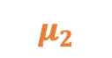
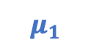


Similar “enough”
“Significantly” different
aegis4048.github.io
aegis4048.github.io
$$μ_{1}$$
$$μ_{2}$$
$$μ_{1}$$
$$μ_{2}$$

Slide 4



























Population
Samples
aegis4048.github.io
aegis4048.github.io

Slide 5
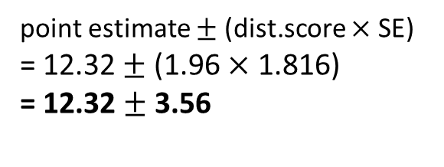
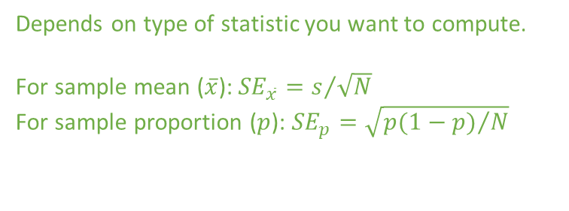
Depends on type of distribution. Tells how many standard deviation away is the limit from the center
point estimate $±$ (dist.score $×$ SE)
= 12.32 $±$ (1.96 $×$ 1.816)
= 12.32 $±$ 3.56
Depends on type of statistic you want to compute.
For sample mean ($\overline{x}$): ${SE}_{\overline{x}}=s/{\sqrt{N}}$
For sample proportion ($p$): ${SE}_{p}=\sqrt{{p(1−p)}/N}$

Slide 6
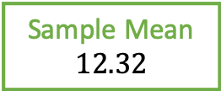
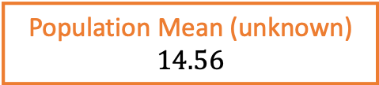
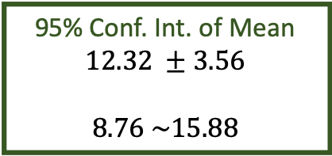
Distribution of Population
falls between 4.70 and 24.42
Lower Limit
Lower Limit
4.70
24.42
95% Conf. Int. of Mean
$$12.32 ±3.56$$
$$8.76 \sim 15.88$$
Population Mean (unknown)
$$14.56$$
Sample Mean
$$12.32$$
aegis4048.github.io

Slide 7
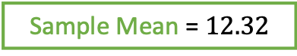
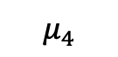


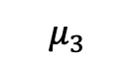
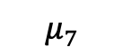

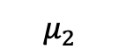
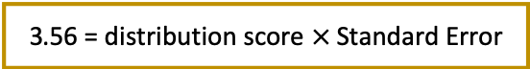
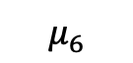
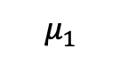

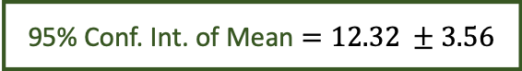
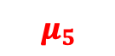
Lower Limit
95% chance that population mean
falls between 8.76 and 15.88
Upper Limit
8.76
15.88
95% Conf. Int. of Mean $=12.32 ±3.56$
$$−3.56$$
$$+3.56$$
$$−(dist.score×SE)$$
$$+(dist.score×SE)$$
aegis4048.github.io
3.56 = distribution score $×$ Standard Error
2.5%
outliers
2.5%
outliers
Sample Mean = $12.32$
$$μ_{1}$$
$$μ_{2}$$
5% chance
$$μ_{3}$$
$$μ_{4}$$
$$μ_{5}$$
$$μ_{6}$$
$$μ_{7}$$

Slide 8

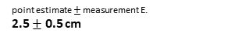
100% chance that your clip length
falls between 2cm and 3cm
2.?? cm
depends on tick mark spacing
1
2
3
4
5
6
7
8
point estimate $±$ measurement E.
2.5 $±$ 0.5 cm
cm
aegis4048.github.io

Slide 9
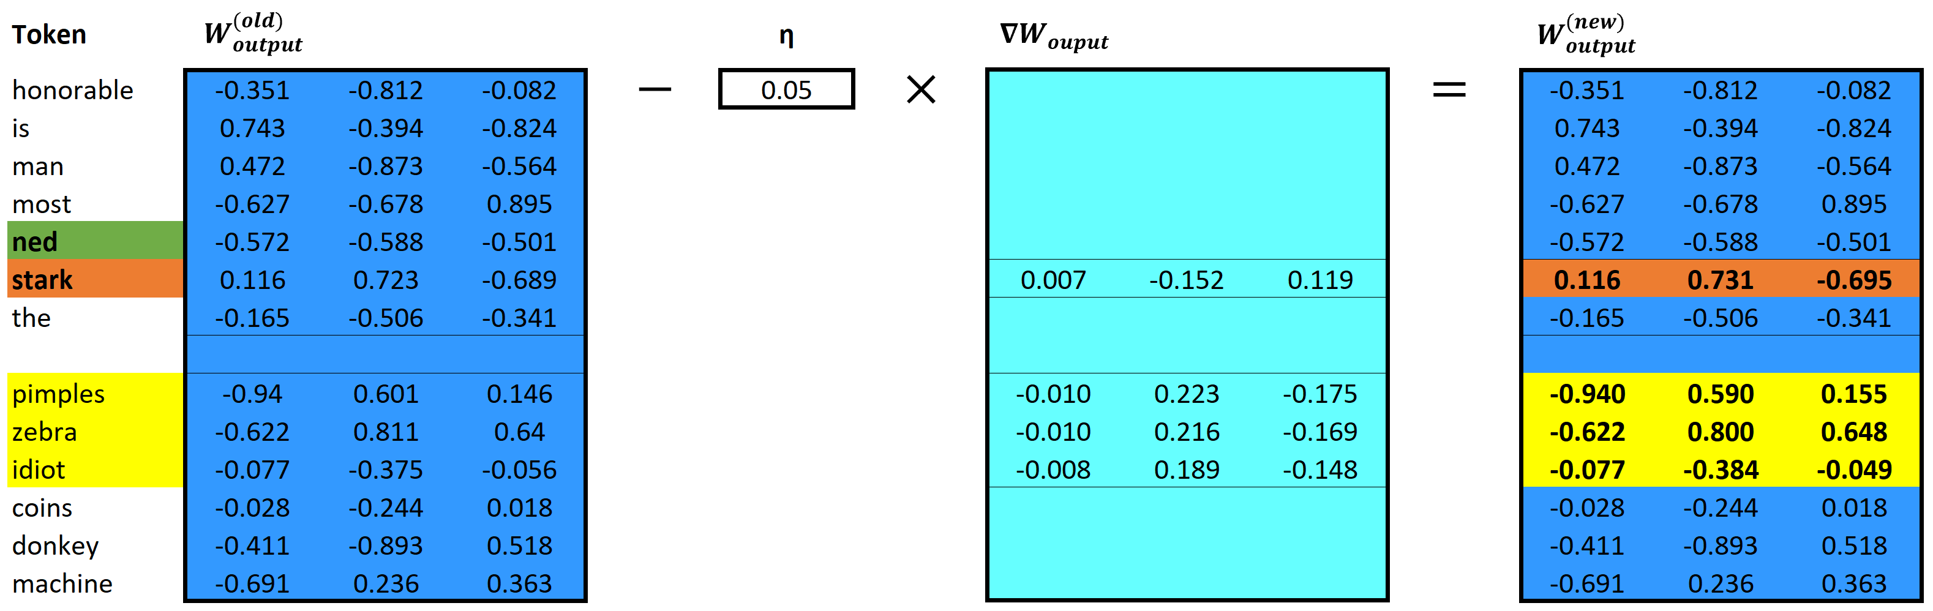
aegis4048.github.io
aegis4048.github.io

Slide 10
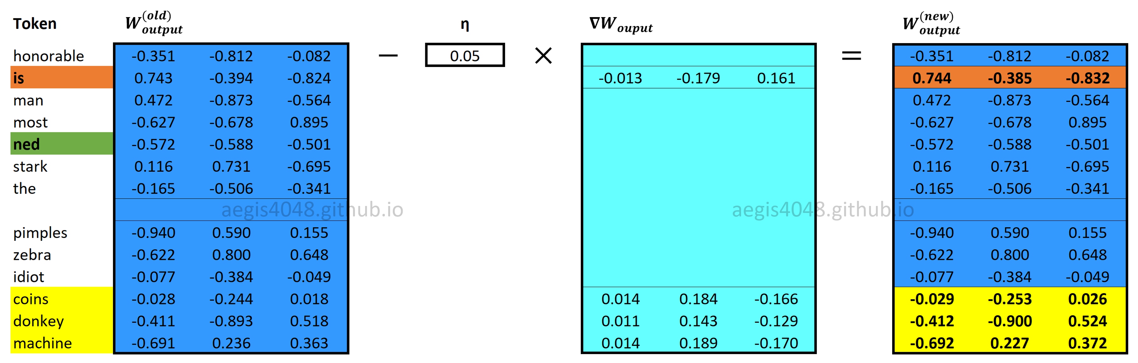

Slide 11
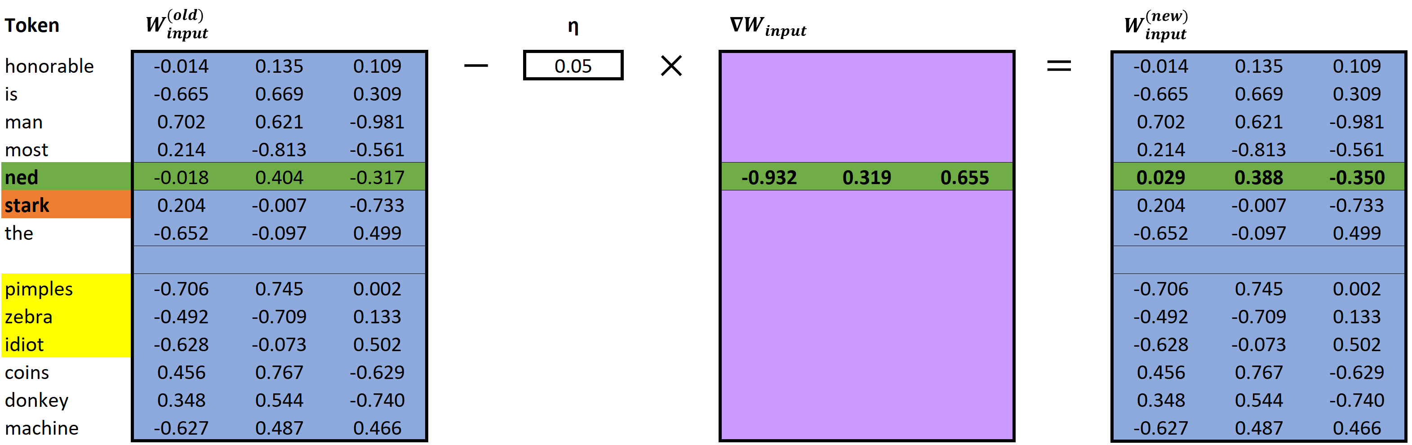
aegis4048.github.io
aegis4048.github.io

Slide 12
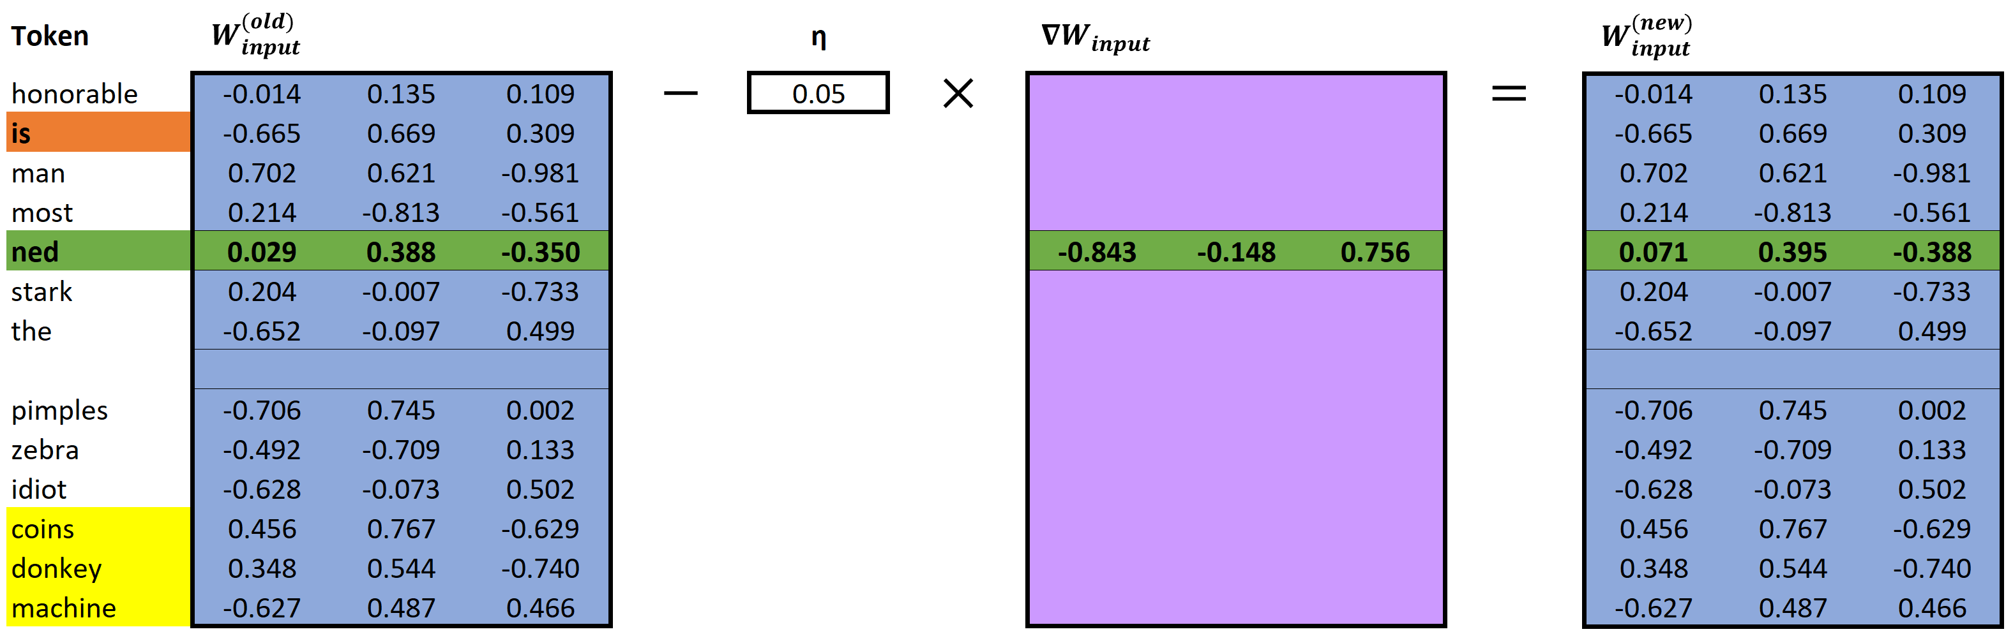
aegis4048.github.io
aegis4048.github.io

Slide 13
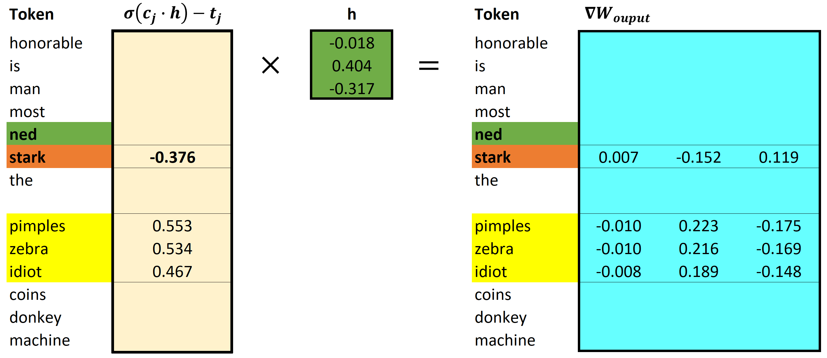
aegis4048.github.io
aegis4048.github.io

Slide 14
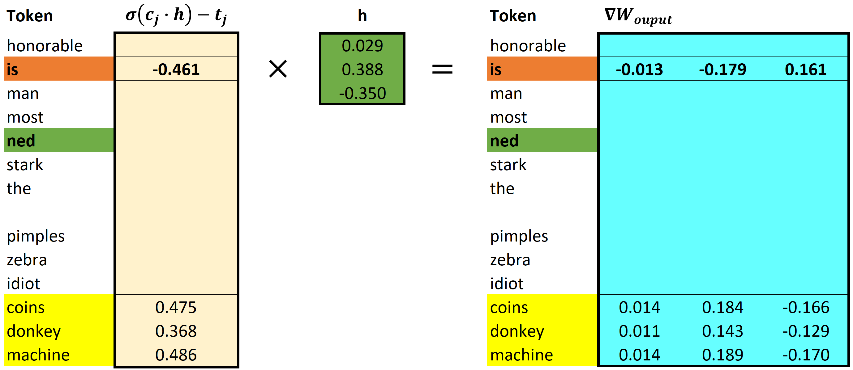
aegis4048.github.io
aegis4048.github.io

Slide 15
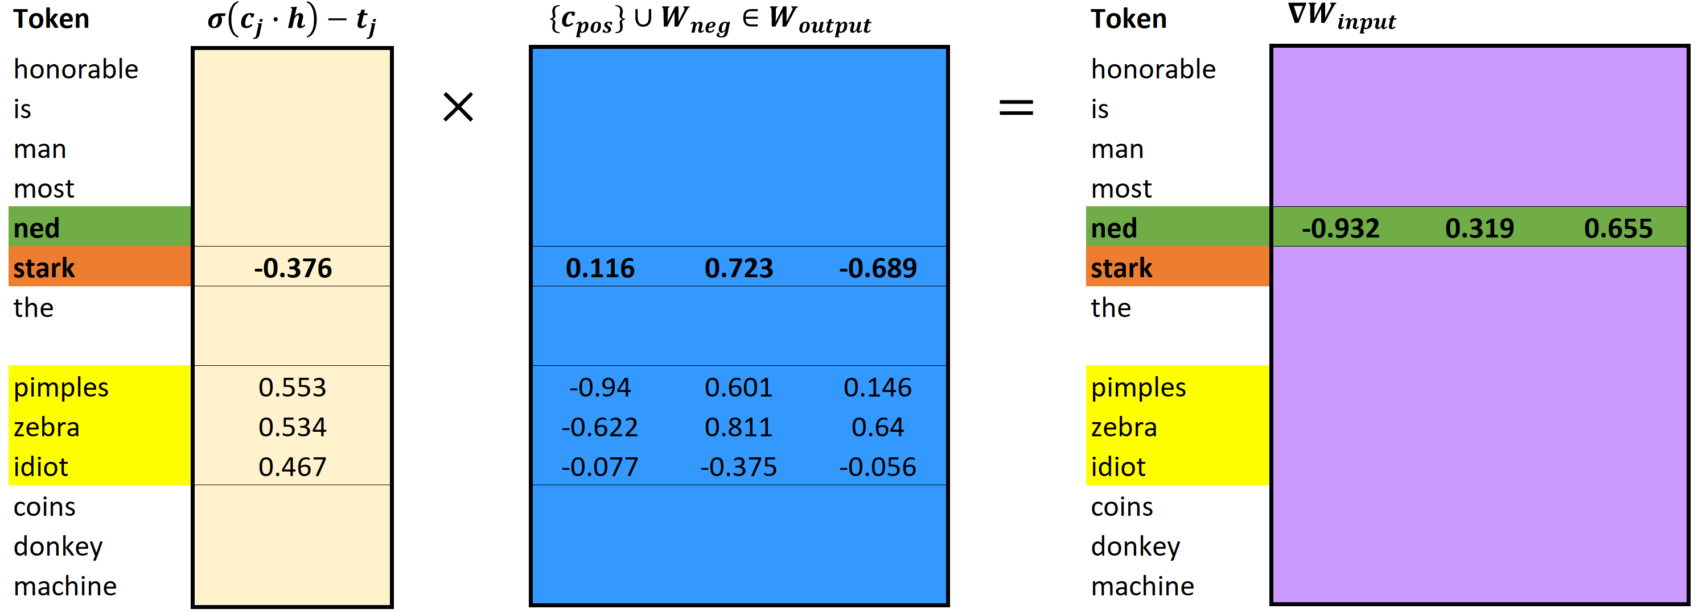
aegis4048.github.io
aegis4048.github.io

Slide 16
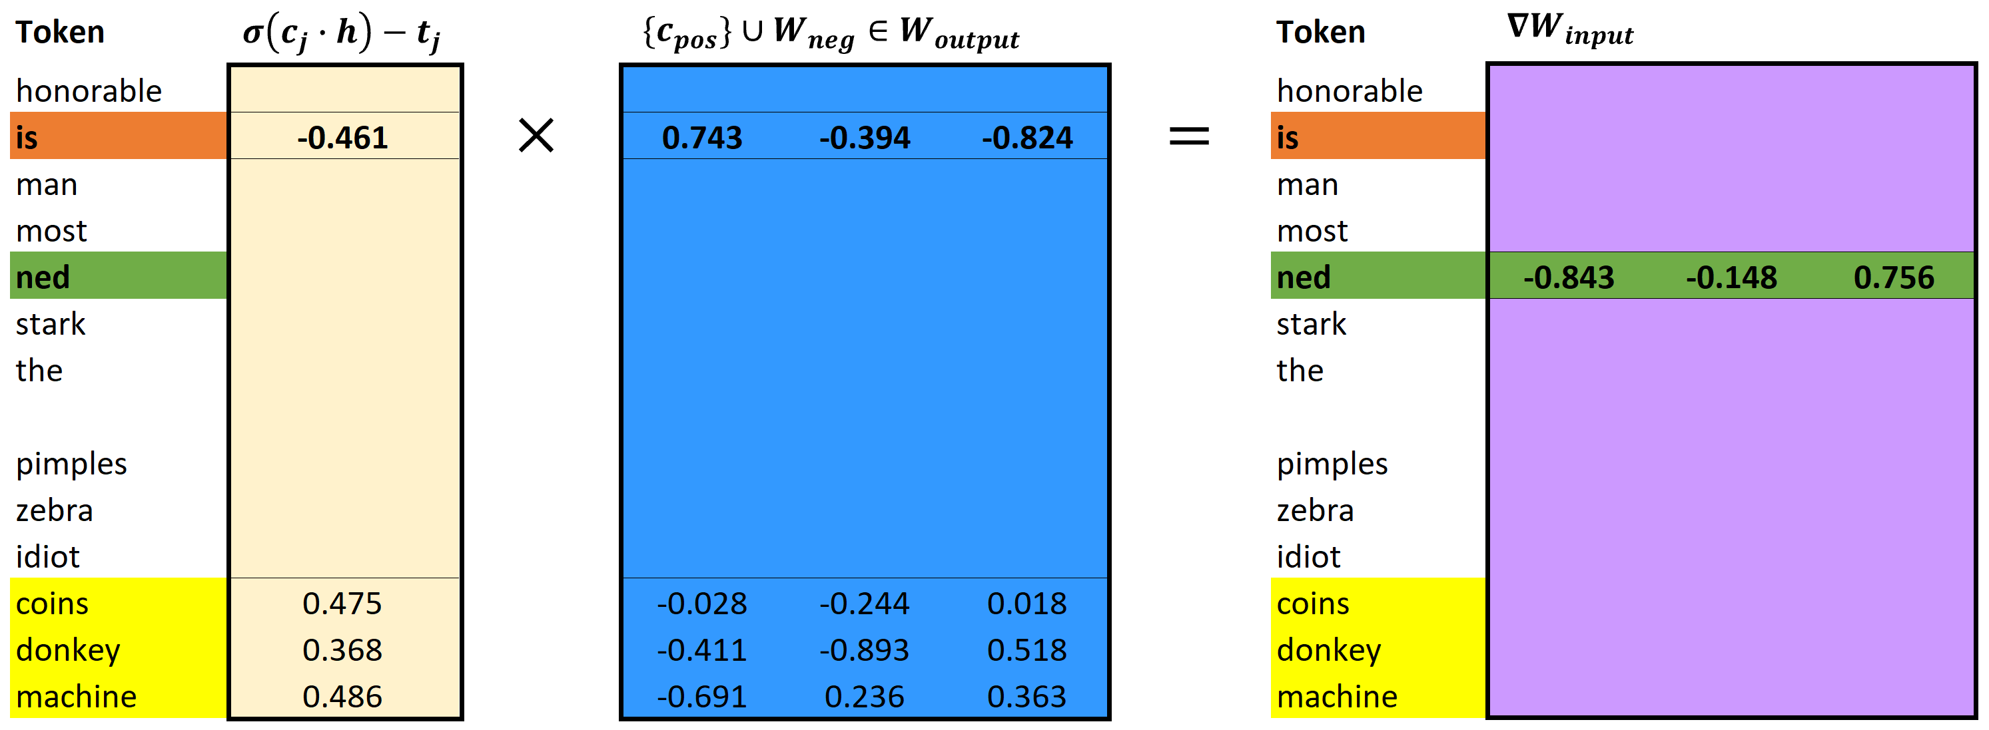
aegis4048.github.io
aegis4048.github.io

Slide 17
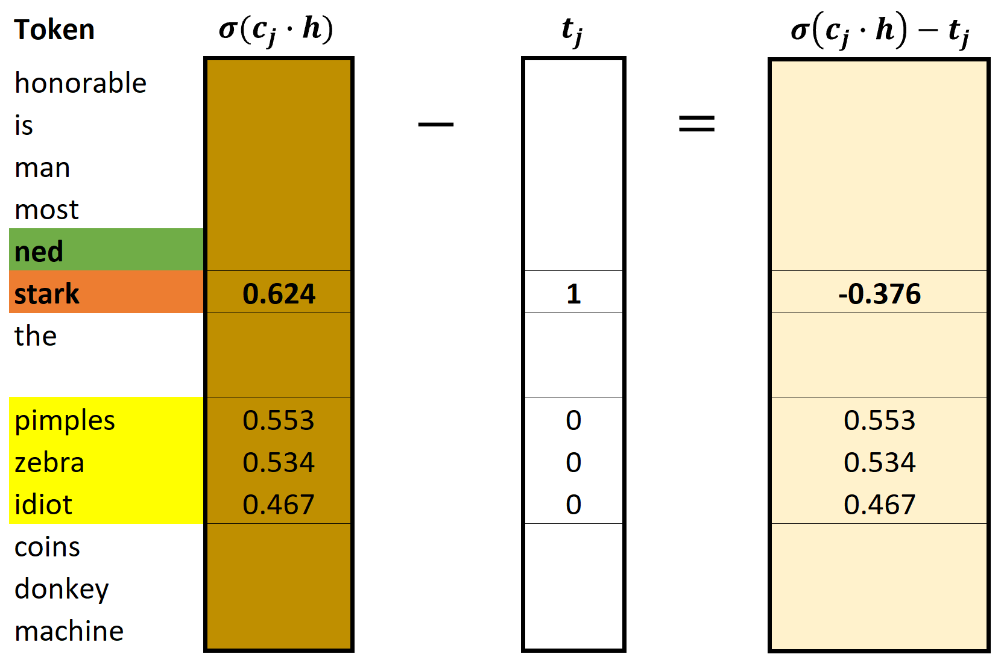
aegis4048.github.io
aegis4048.github.io

Slide 18
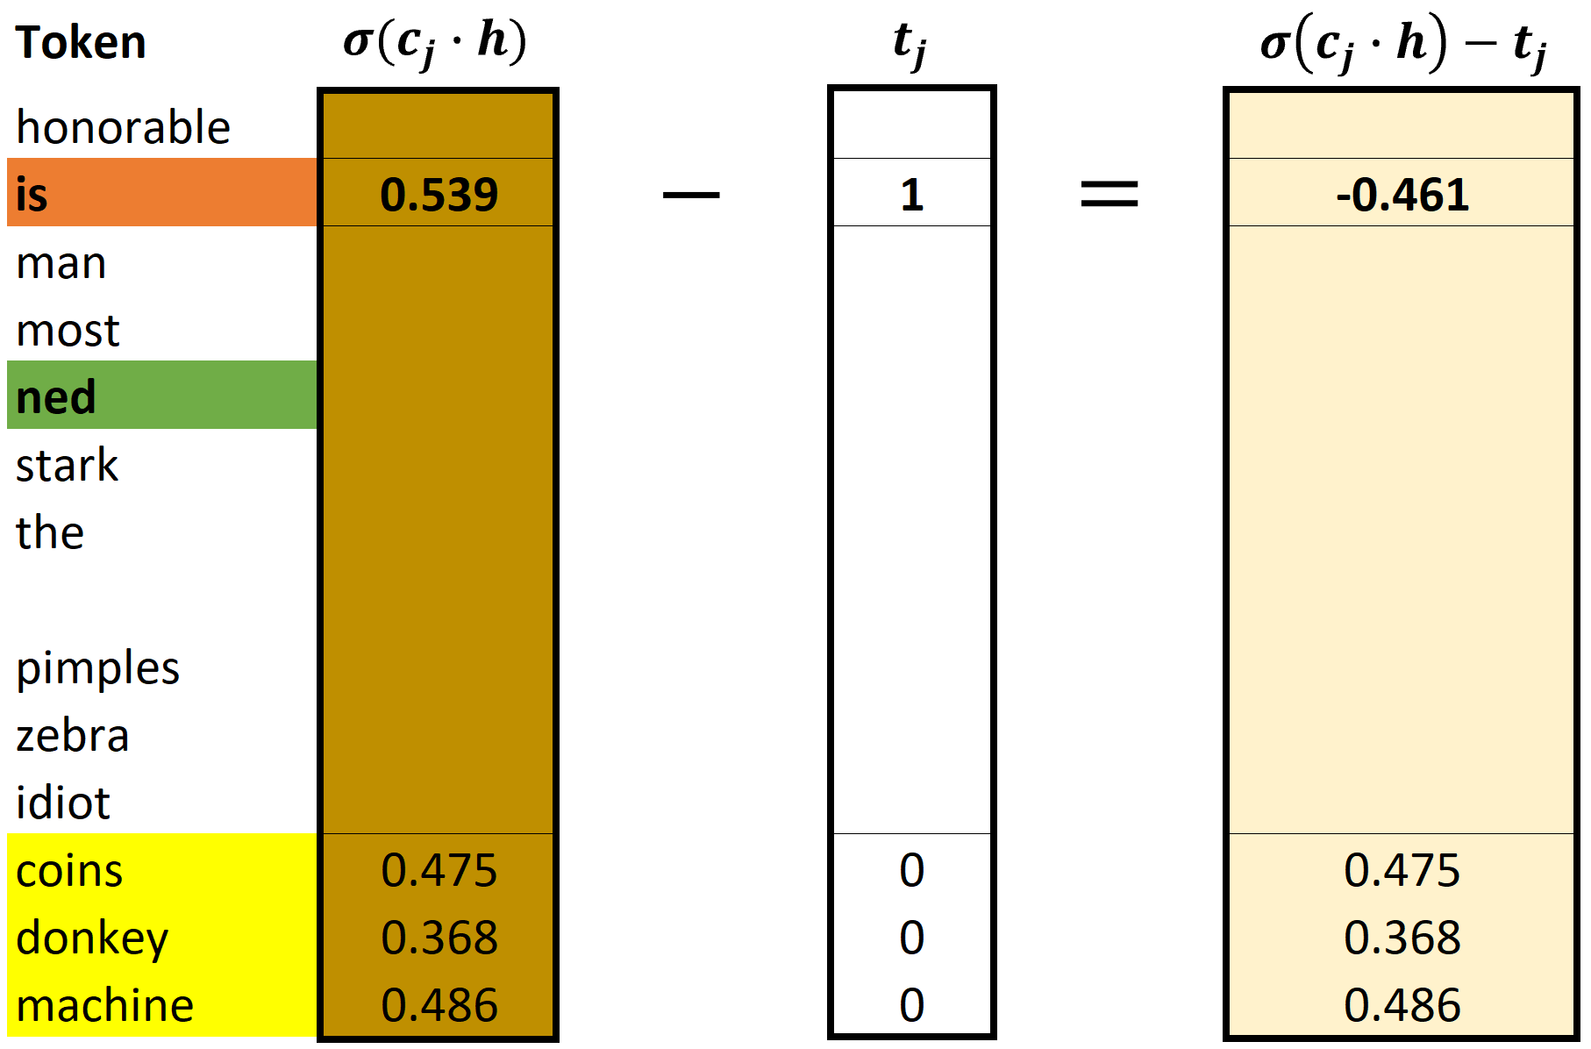
aegis4048.github.io
aegis4048.github.io

Slide 19
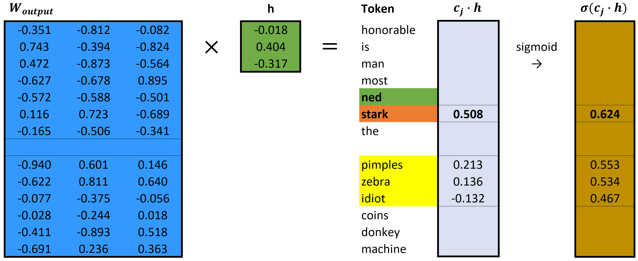
aegis4048.github.io
aegis4048.github.io

Slide 20

aegis4048.github.io
aegis4048.github.io

Slide 21


aegis4048.github.io

Slide 22

aegis4048.github.io

Slide 23


Binomial Classification
(regression, logistic)
(regression, zebra)
(regression, machine)
(regression, pimples)
(regression, sigmoid)
VS
(regression, Gangnam-Style)
(regression, supervised)
(regression, toothpaste)
aegis4048.github.io
(regression, neural)
(regression, idiot)
Likely to observe
$$p(D=1|w,c_{pos})≈1$$
Unlikely to observe
$$p(D=1|w,c_{neg})≈0$$

Slide 24



True: $σ\left(x\right)$ > 0.5
False: $σ\left(x\right)$ < 0.5
aegis4048.github.io

Slide 25

aegis4048.github.io
aegis4048.github.io

Slide 26










Center word: drilling
$$K=5$$
$$iter=1$$
$$iter=2$$
$$iter=3$$
$$iter=4$$
Current context word: engineer
$$p\left(D=1 | w_{drilling},c_{engineer}\right)$$
$$p(D=1|w_{drilling},c_{minimized})$$
$$p(D=1|w_{drilling},c_{primary})$$
$$p(D=1|w_{drilling},c_{concerns})$$
$$p(D=1|w_{drilling},c_{led})$$
$$p\left(D=1 | w_{drilling},c_{page}\right)$$
0.432
0.312
0.565
0.102
0.853
0.642
0.653
0.169
0.221
0.043
0.532
0.380
0.853
0.042
0.083
0.009
0.115
0.101
0.998
0.000
0.001
0.000
0.001
0.002
engineer
minimized
Update $θ$
Update $θ$
Update $θ$
primary
$$=$$
concerns
led
aegis4048.github.io
aegis4048.github.io
aegis4048.github.io
page

Slide 27
Drilling fluids serve to balance formation pressures while drilling to ensure wellbore stability. They also carry cuttings to the surface and cool the bit. The drilling engineer traditionally designs drilling fluids with two primary goals in mind:
To ensure safe, stable boreholes, which is accomplished by operating within an acceptable mud-weight window
To achieve high rates of penetration so that rig time and well cost can be minimized
These primary considerations do not include well productivity concerns. A growing recognition of the importance of drilling-induced formation damage has led to the use of drill-in fluids (fluids used to drill through the pay zone) that minimize formation damage. This page discusses the formation damage that may be associated with various types of drilling fluids.
current context word
aegis4048.github.io
aegis4048.github.io

Slide 28

Vanilla Skip-Gram
aegis4048.github.io
aegis4048.github.io
Negative Sampling
aegis4048.github.io
aegis4048.github.io

Slide 29




Complexity = $O\left(V+V\right)≈O\left(V\right)$
where $V$ is very large
Computed $V$ times
for all vocabs
aegis4048.github.io
$V$ computations are needed to get normalization factor

Slide 30

aegis4048.github.io

Slide 31

aegis4048.github.io

Slide 32

aegis4048.github.io
aegis4048.github.io
aegis4048.github.io

Slide 33

aegis4048.github.io
aegis4048.github.io
aegis4048.github.io

Slide 34

aegis4048.github.io

Slide 35

aegis4048.github.io
aegis4048.github.io
aegis4048.github.io

Slide 36

aegis4048.github.io
aegis4048.github.io
aegis4048.github.io

Slide 37





$$c=1$$
$$c=2$$
0.12
0.21
0.10
0.06
-0.87
0.09
0.12
0.21
0.10
0.06
0.13
-0.91
0.24
0.42
0.20
0.12
-0.74
-0.82
man
passes
$$\sum_{c=1}^{C}{e_{c}}=$$
sentence
$$+$$
$$=$$
should
aegis4048.github.io
the
who

Slide 38






$$y_{true}$$
($V$-dim)
$$y_{pred}−y_{true}$$
($V$-dim)
0
0
0
0
1
0
0.12
0.21
0.10
0.06
-0.87
0.09
man
$$y_{pred}$$
($V$-dim)
passes
sentence
$$=$$
should
0.12
0.21
0.10
0.06
0.13
0.09
$$−$$
c = 1
the
who
aegis4048.github.io
0
0
0
0
0
1
0.12
0.21
0.10
0.06
0.13
-0.91
man
$$−$$
passes
sentence
$$=$$
should
c = 2
the
who

Slide 39
Dimension 3
0.11
0.34
0.54
Achieve
Achieve
Success
aegis4048.github.io
aegis4048.github.io
0.51
0.91
0.65
Success
Dimension 1
Vector distance
Dimension 2

Slide 40
Training Samples
Source Text
The
man
who
passes
the
sentence
should
swing
the
sword.
(passes, who)
(passes, the)

Slide 41
Dimension 3
should
passes
0.1 0.2 0.7
passes
aegis4048.github.io
should
-2 0.2 0.8
aegis4048.github.io
Dimension 1
Dimension 2

Slide 42





Makes it positive
$$W_{output}∙h$$
Softmax ($W_{output}∙h$)
$$y_{pred}$$
-1.23
0.33
0.18
-5.12
-8.79
-2.01
2.56
4.31
0.12
0.08
0.02
0.13
0.23
0.15
0.11
0.16
$$p\left(y_{i}\right)=\frac{e^{y_{i}^{}}}{\sum_{j}{e^{y_{j}}}}$$
aegis4048.github.io
Normalizes to range [0, 1]
Sum($y_{pred})$ = 1

Slide 43

$$W_{input}$$
($V×N$)
man
2 0.5 4
0.1 0.2 0.7
0.3 -2 0.2
-2 0.2 0.8
1 0.7 3
3 5 0.2
passes
sentence
should
aegis4048.github.io
the
who

Slide 44




$$y_{true}$$
($V$-dim)
$$y_{pred}−y_{true}$$
($V$-dim)
0
0
0
0
1
0
0.12
0.21
0.10
0.06
-0.87
0.09
man
$$x$$
($V$-dim)
$$W_{input}$$
($V×N$)
$$h$$
($N$-dim)
$$W_{output}^{T}$$
($N×V$)
$$y_{pred}$$
($V$-dim)
passes
sentence
$$=$$
should
man
0
1
0
0
0
0
2 0.5 4
0.1 0.2 0.7
0.3 -2 0.2
-2 0.2 0.8
1 0.7 3
3 5 0.2
0.12
0.21
0.10
0.06
0.13
0.09
$$−$$
c = 1
passes
the
sentence
0.1
0.2
0.7
0.3 0.1 0.4 -0.4
0.1 0.3 -1.1 0.3
0.1 0.2 0.4 0.1
who
should
aegis4048.github.io
aegis4048.github.io
0
0
0
0
0
1
0.12
0.21
0.10
0.06
0.13
-0.91
man
the
$$−$$
passes
who
sentence
$$=$$
should
c = 2
Input Layer one-hot encoded vector
Word-Embedding matrix – a.k.a “Lookup table”
Hidden (Projection)
Layer for center word (passes)
Word-Embedding matrix for context words (the, who)
Softmax Output
Layer of range
[0, 1)
Sum = 1
the
who
Prediction Error – a.k.a function loss

Slide 45





$$x$$
($V$-dim)
$$W_{input}$$
($V×N$)
$$h$$
($N$-dim)
man
0
1
0
0
0
0
2 0.5 4
0.1 0.2 0.7
0.3 -2 0.2
-2 0.2 0.8
1 0.7 3
3 5 0.2
passes
sentence
0.1
0.2
0.7
Projection of word vector for “passes” from the embedding matrix
should
$$×$$
$$=$$
aegis4048.github.io
the
who

Slide 46







Input Layer ($x$)
($V$-dim)
Assuming Stochastic Gradient Descent…
Center Word
($w_{t}$)
v=0
v=1
v=2
v=3
v=4
v=5
v=6
v=7
man passes sentence should swing sword the who
t=0
The
0 0 0 0 0 0 1 0
t=0
$$θ_{new}=θ_{old}−η∙∇_{θ}J_{0}(θ;w^{(0)})$$
t=1
man
1 0 0 0 0 0 0 0
$$θ_{new}=θ_{old}−η∙∇_{θ}J_{1}(θ;w^{(1)})$$
t=2
who
0 0 0 0 0 0 0 1
$$θ_{new}=θ_{old}−η∙∇_{θ}J_{2}(θ;w^{(2)})$$
aegis4048.github.io
aegis4048.github.io
t=9
sword
0 0 0 0 0 1 0 0
$$θ_{new}=θ_{old}−η∙∇_{θ}J_{9}(θ;w^{(9)})$$

Slide 47



Slide 48

killowatt
electricity
aegis4048.github.io
aegis4048.github.io
Oil Producers
Barrels + bpd

Slide 49

Oil Producers
Barrels + bpd
killowatt
electricity
aegis4048.github.io

Slide 50

electricity
killowatt
Barrels + bpd
Oil Producers
aegis4048.github.io

Slide 51
0
0
0.32
0.79
0
0.05
0.10
0
0
0.91
Achieve
aegis4048.github.io
aegis4048.github.io
0
0
0.34
0.75
0
0.10
0
0
0
0.87
Success

Slide 52
Dimension 3
0.11
0.34
0.54
Achieve
Achieve
Success
aegis4048.github.io
aegis4048.github.io
0.51
0.91
0.65
Success
Dimension 1
Dimension 2

Slide 53

aegis4048.github.io

Slide 54













2$m$
variance ($γ$)
sill ($σ^{2}$)
z($u_{α1}$)
z($u_{α1}+2m$)
2$m$
2$m$
2$m$
z($u_{α4}$)
z($u_{α4}+2m$)
nugget ($c_{0}$)
z($u_{α2}$)
z($u_{α2}+2m$)
2$m$
range ($a$)
range
z($u_{α3}$)
z($u_{α3}+2m$)
lag distance (h)

Slide 55









3$m$
variance ($γ$)
sill ($σ^{2}$)
z($u_{α1}$)
z($u_{α1}+3m$)
3$m$
3$m$
z($u_{α3}$)
z($u_{α3}+3m$)
nugget ($c_{0}$)
range ($a$)
3$m$
range
z($u_{α2}$)
z($u_{α2}+3m$)
lag distance (h)

Slide 56




variance ($γ$)
sill ($σ^{2}$)
nugget ($c_{0}$)
range ($a$)
lag distance (h)

Slide 57


z($u_{α}$)
h
z($u_{α}+h$)

Slide 58








h
z($u_{α1}$)
z($u_{α1}+h$)
h
h
z($u_{α2}$)
z($u_{α2}+h$)
z($u_{α1}$)
z($u_{α}+h$)
h
z($u_{α3}$)
z($u_{α3}+h$)

Slide 60
Y axis (North)
Lag Tolerance
Lag 3
Azimuth
Lag 2
Bandwidth
Lag 1
Azimuth Tolerance
X axis (East)

Slide 61

Z axis (vertical)
Horizontal Major
Horizontal Major
Azimuth
Horizontal Minor
Horizontal Minor
Horizontal Minor
$$θ$$
X axis (East)
Y axis (North)

Slide 62
Y axis (North)
Lag 3
Lag 2
Lag 1
X axis (East)

Slide 63

aegis4048.github.io
aegis4048.github.io
aegis4048.github.io
aegis4048.github.io

Slide 64

aegis4048.github.io

Slide 65

aegis4048.github.io

Slide 66

aegis4048.github.io

Slide 67

aegis4048.github.io

Slide 68

aegis4048.github.io
aegis4048.github.io

Slide 69

aegis4048.github.io

Slide 70

aegis4048.github.io

Slide 71


